Slide 1
NATURAL HAZARDS DETECTION AND CLASSIFICATION
D i s a s t e r C l a r i t y T h r o u g h I n t e l l i g e n t V i s i o n

Slide 2

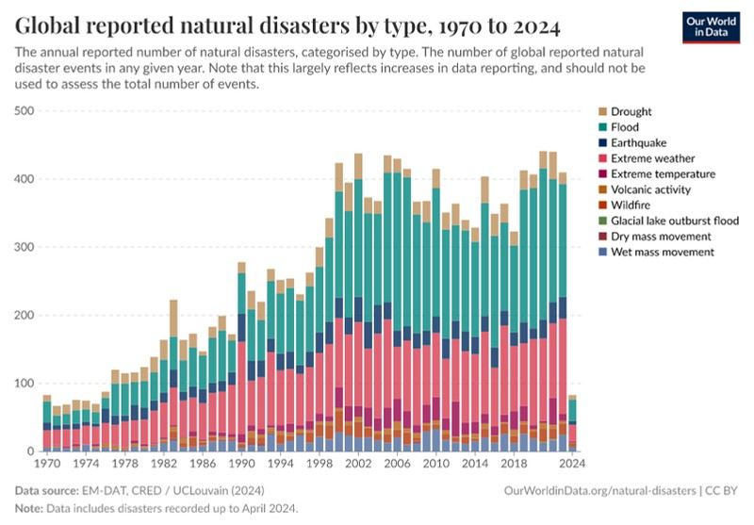
INTRODUCTION
Natural disasters such as floods, wildfires, earthquakes, and cyclones can cause massive destruction in a matter of moments. Early detection and accurate classification of these events are critical for saving lives and reducing damage.
OBJECTIVE:
In this project, we developed a Convolutional Neural Network (CNN) model that can automatically analyze and classify disaster images, enabling faster, smarter response efforts using AI

Slide 3
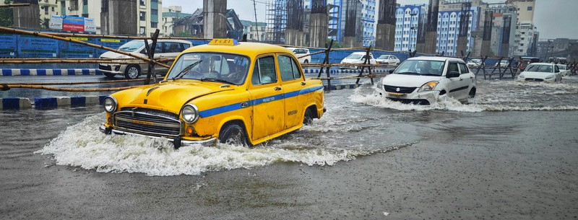
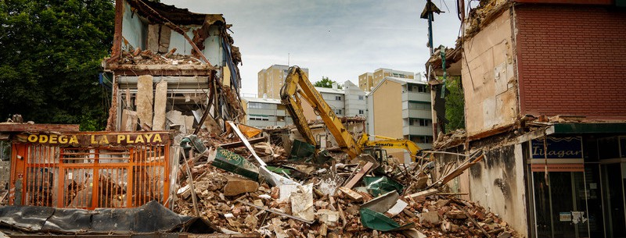
PROBLEM STATEMENT
Detail
Natural disasters occur frequently and cause widespread damage to human lives, infrastructure, and the environment. Rapid identification of these events through image data is critical for timely emergency response and risk mitigation.
Cause
The lack of automated classification systems is mainly because of problems like poor image quality, not enough labeled data, and no smart systems that can detect disasters in real time. These issues make it difficult for traditional methods to understand and classify disaster images quickly and accurately.
Impact
Without fast and accurate classification, authorities face delays in response, inefficient resource deployment, and higher recovery costs, which ultimately lead to greater loss of life and property.

Slide 4
DATASET

Slide 5

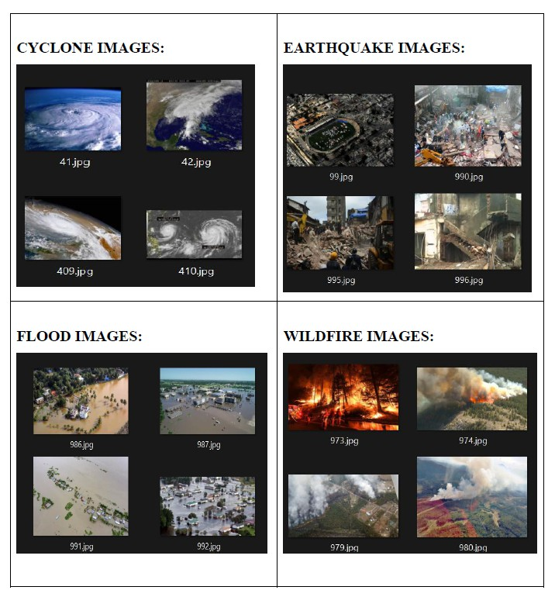
DATASET DESCRIPTION
T h e d a t a s e t u s e d i n t h i s s t u d y i s t h e C y c l o n e - W i l d f i r e - F l o o d - E a r t h q u a k e D a t a b a s e , s o u r c e d f r o m K a g g l e . I t c o n t a i n s l a b e l e d i m a g e s
r e p r e s e n t i n g f o u r m a j o r n a t u r a l d i s a s t e r c l a s s e s : C y c l o n e , W i l d f i r e , F l o o d , a n d
E a r t h q u a k e . E a c h o f t h e s e c l a s s e s c o n t a i n i m a g e c o u n t a s f o l l o w s :
C y c l o n e : 9 2 8 i m a g e s
E a r t h q u a k e : 1 , 3 5 0 i m a g e s
F l o o d : 1 , 0 7 3 i m a g e s
W i l d f i r e : 1 , 0 7 7 i m a g e s

Slide 6
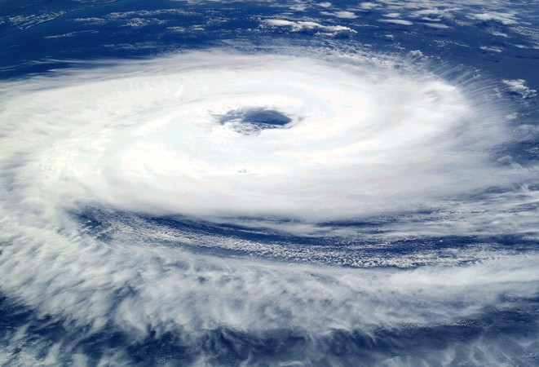
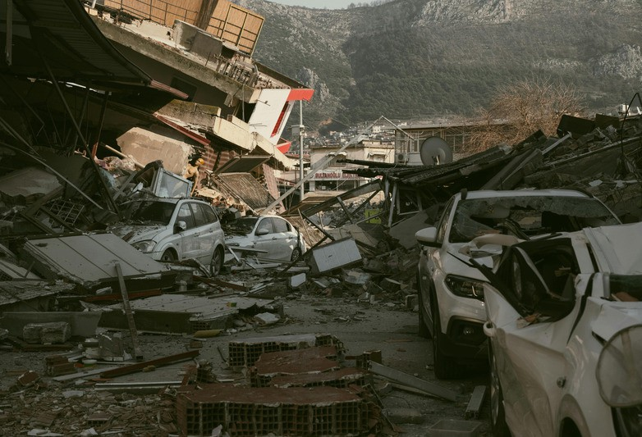
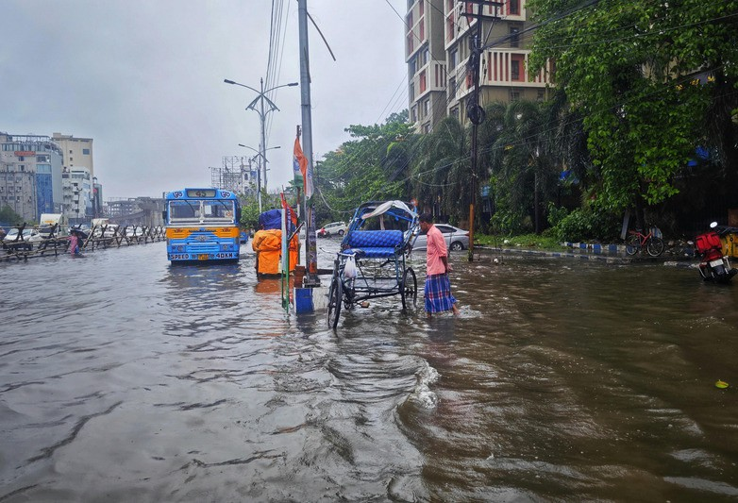
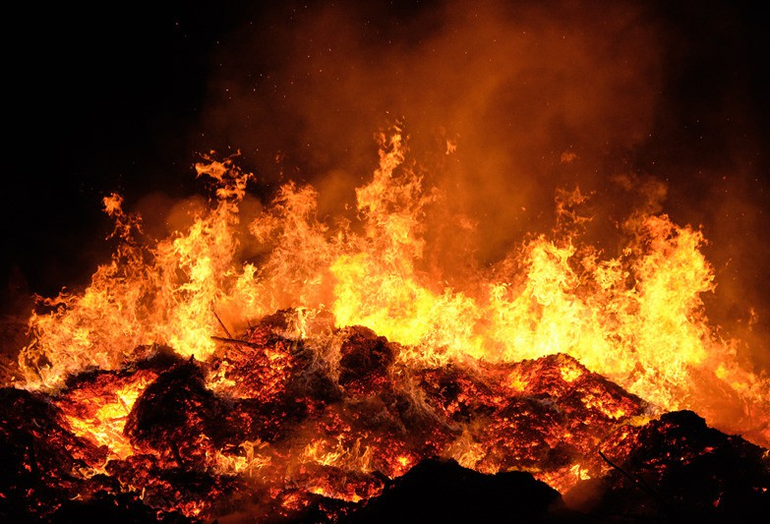
PREPROCESSING
Normalization
Image Resizing
Dataset Split
Rescaled all pixel values from [0, 255] to [0, 1]
All images resized to
128×128 pixels
80% Training, 20% Validation
Achieved using: rescale=1./255 in ImageDataGenerator
Ensures consistent input shape: (128, 128, 3)
Handled with validation_split=0.2 in ImageDataGenerator
Chosen to balance spatial detail and training efficiency
Purpose: Improves model convergence and numerical stability
Ensures unbiased evaluation and supports early stopping
Image Batching: Images were processed in batches of 32 to optimize memory usage and training efficiency.

Slide 7

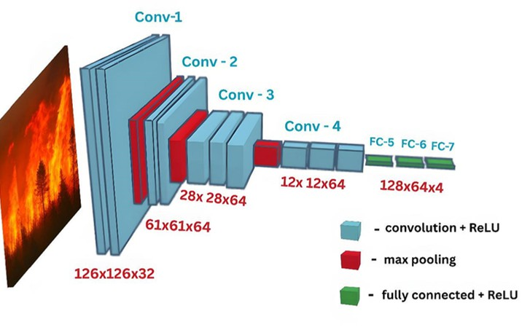
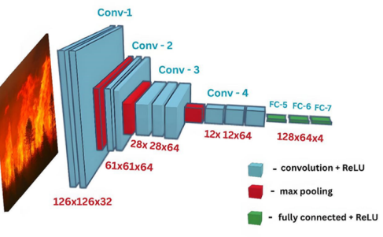
MODEL IMPLEMENTATION
CNN Architecture
Conv2D layers use kernels (3x3) to extract first low level features, eventually progressing to higher level features
MaxPooling2D layers reduce spatial dimensions, reducing noise and reliance on feature position Dropout layers deactivate a proportion of neurons (1/2 or 1/4) as regularisation against overfitting
Flatten layer converts 3D tensor (height, width, colour) to 1D vector
FCL, or Dense layers, uses extracted to features and learns relationships between them
Output layer gives the final classification threshold in the form of logits (scores ∞ to -∞) for each class
Activation ReLU allows the model to capture non-linear patterns and relationships
Sofmax is applied internally due to CategoricalCrossEntropy(Logits=true) in loss function for numerical stability (like preventing overflow and log problems). This takes raw logits and converts them to probabilities (0 to 1 score) used to classify images.

Slide 8
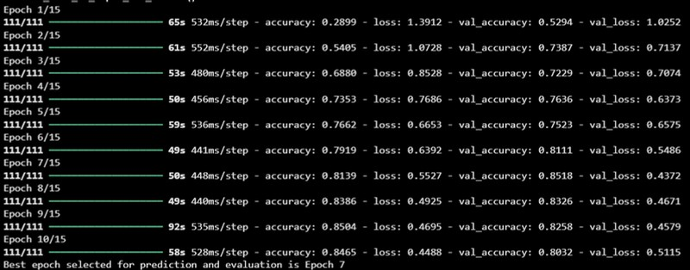
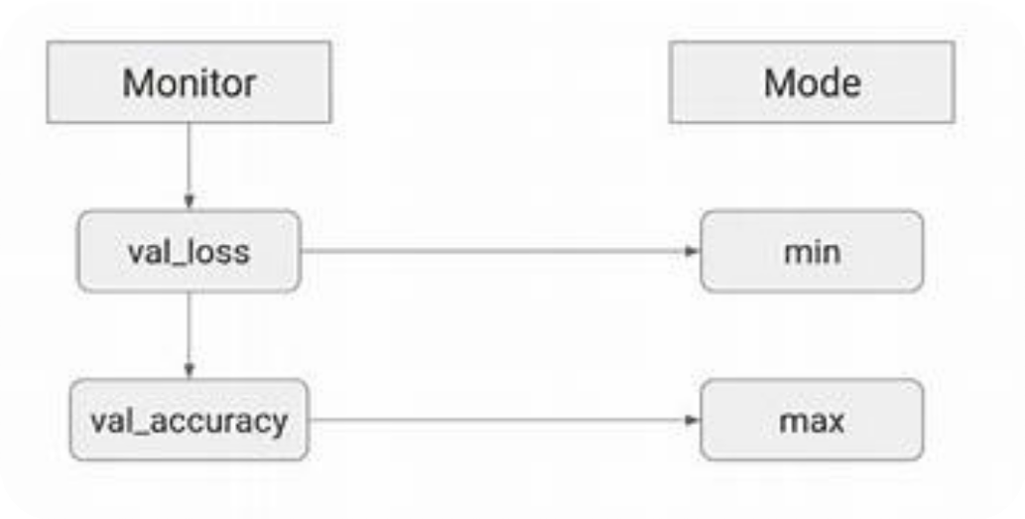
MODEL IMPLEMENTATION
Model Training
Data Generators: The model is trained using train_generator and val_generator, enabling efficient batch processing and data augmentation for robust training, especially with image data.
Model Compilation: Utilizes the
adam optimizer and the loss function when
CategoricalCrossentropy(from_logits=True) as
converting raw scores to probabilities for multi-class classification. Accuracy is tracked as a key metric.
Early Stopping: Actively monitors the val_loss (validation loss) and automatically stops training if it doesn't improve for 3 consecutive epochs, critically preventing overfitting and saving computational resources.
Model Checkpointing: Employs a checkpoint to save only the model's weights (save_weights_only=True). Crucially, it's configured to save_best_only=True based on the lowest observed val_loss, ensuring that the most optimally performing model (in terms of generalization) is always preserved.
Iterative Training & Best Epoch Selection: The model trains up to 15 epochs, but early stopping typically intervenes. Post-training, the specific epoch with the lowest val_loss is automatically identified and confirmed, representing the saved, optimally generalized model.

Slide 9

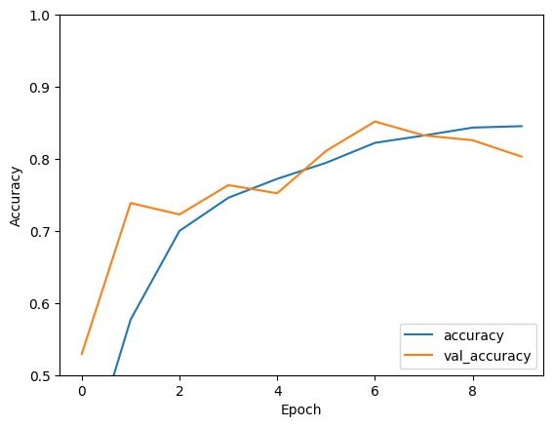
RESULTS
This graph shows the accuracy accross epochs. val_accuracy increased between epoch 4 & 6 then declined at 7 which shows the importance of early stopping.
After epoch 7, the model began to overfit, meaning, the model is learning the training data too well but losing generalization ability.
Training accuracy increased steadily in a logarithmic pattern, showing diminishing returns with each epoch.

Slide 10
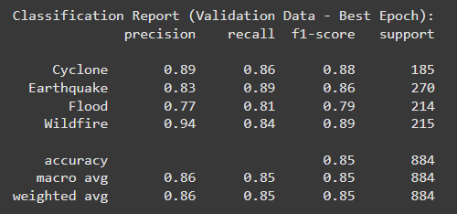
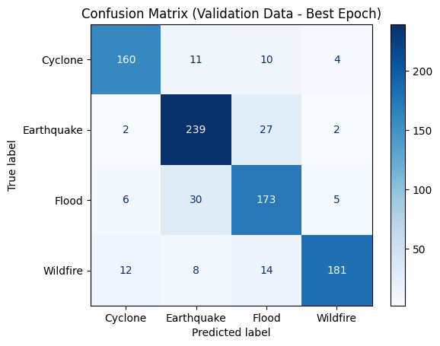
RESULTS
The classificatoin report shows that the model has an accuracy of 85%. The model performed the best on the Wildfire class with 0.94 precision.
One issue found in the confusion matrix was the confusion between floods and earthquakes, where the model often predicted one when the other was actually correct.
These misclassifications suggest feature overlap or insufficient distinction between the two disaster types in the dataset.

Slide 11
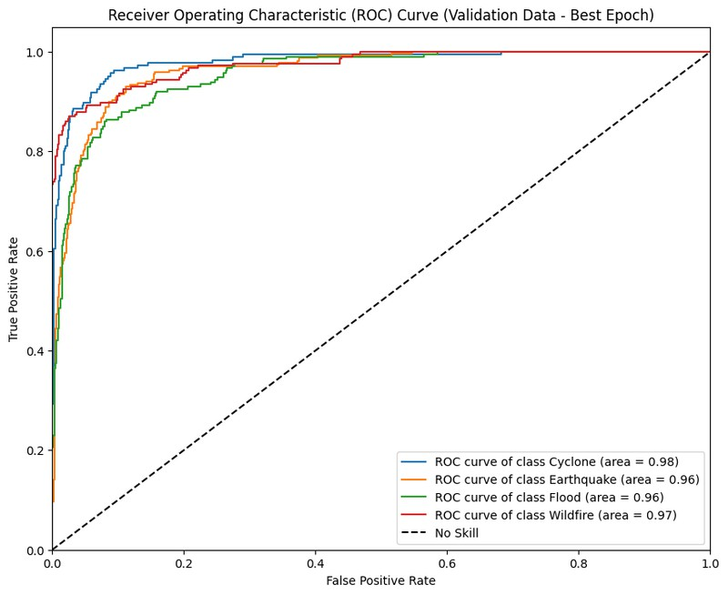
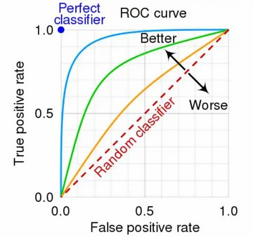
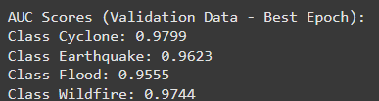
RESULTS
These are the ROC curves and the AUC scores for each of the 4 classes. As shown in the ROC curve, the model is performing well as the curves are closer to the top left corner. Moreover, the AUC scores are showing that the model has a high classification power as all the 4 AUC scores are closer to 1 meaning the model is doing a good job in classifying the classes.

Slide 12
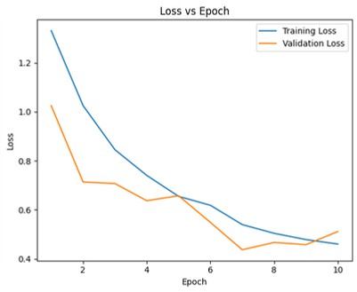
RESULTS
Training and validation loss decreased steadily as epochs increased.
The loss curves flatten after epoch 8, meaning that the model is learning less with each additional epoch.
The parallel drop in both loss curves shows that the model is optimizing well without major instability.

Slide 13
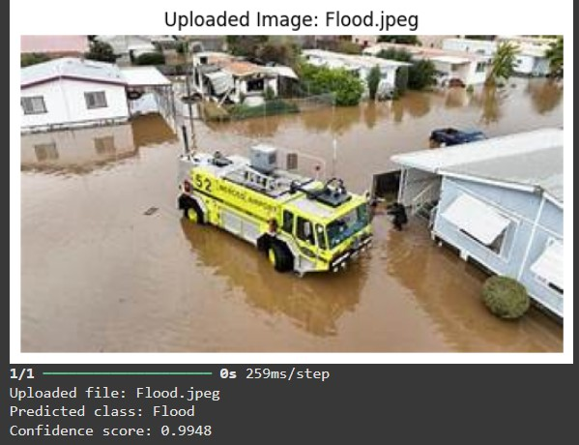
RESULTS
A testing image was given to the model to check if it can predict the class of this image. The model correctly classified the image and has given a high confidence score.

Slide 14




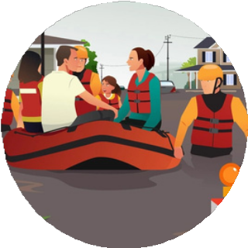
CONCLUSION
Future Improvements
Challenges
Images of Different Sizes
Extra Elements in Image
Integration of Deeper Architectures
Transfer Learning model
Identical Visual Patterns
Real-Time Disaster Detection and Deployment

Slide 15
Thank You
A N Y Q U E S T I O N S ?

